Slide 1

UNCENSORED SOCIAL MEDIA UTILITY
FINAL YEAR PROJECT

Slide 2
PRESENTERS
EDWARD KIZITO
COLLINS O. BUNDE

Slide 3
Problem
Organization Challenges:
Employees/Insider (weakest link
In the security chain)
Customers/Outsiders
    Company and Brand Reputation Damage
    Other social media Risks

Slide 4
Difficulty in
Protecting Sensitive information like:
Trade secrets

Slide 5
SOLUTION
Social Media Monitory of Company Brand Mentions in real-time
Why?
Will help in applying proactive measures to mitigate risks when this post are seen online.

Slide 6
WHAT CAN BE SEEN?
INSTANCES OF:
Social Media Squatting
Information Leakage
Cyber loafing
Reputation Damage

Slide 7
Objectives
To identify the existing risks of social media utility across Kenyan enterprises.
To suggest mitigation strategy for effective social media use that defines, policy formulation guideline for the enterprise use within the Kenyan industrial realm

Slide 8
Propose a contextualized methodology for brand reputation tracking within the enterprise that can be replicated locally among the Kenyan companies.
Suggest the implementation of such intelligent systems for enhancing privacy and security in social media

Slide 9
Kenyan vision 2030 ICT policy objectives
Establishing a cyber security strategy for national security.
Hence need for effective social media policy to be inculcated
cyber security strategy will help in driving economic dev.
Protecting cyberspace reliant societies against cyber threats.
Reason for mitigating risks in social media as well

Slide 10
METHODOLOGY
Agile Scrum Methodolgy
WHY?
best suited for products intended for an industry with rapidly changing standards, system should be flexible to adjust to the new needs

Slide 11
Cont:
Clients will always change the scope of the project. Enterprises have different needs and working environments, hence changing the scope is inevitable.

Slide 12
Cont:
Functionalities can be tested before without regard to the quality.

Slide 13
Key Findings
Reputation Damage is rampant on social Media i.e. Twitter

Slide 14
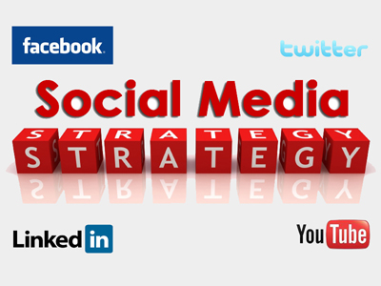
IMPACT
Social Networking Policies
Application of Local intelligent systems such as social media monitory through sentiment analysis.

Slide 15
IMPACT
Enhanced Social Media Security:
Will reduce the effects of risks in social media such as.
Reputation Damage and increase long-term financial gain

Slide 16
Meeting Objectives
Objective 1
  Safaricom Company as Case Study of the project.
  Did sentiment analysis and Crawled 700 tweets of Safaricom mentions to a database.
  The negative tweets were then analyzed for instances of any of the social media risks. We identified instances of Reputation Damage

Slide 17
Objective 2
Modeled a classifier using the following algos:
Logistic Regression, Naïve Bayes Classifier, Multinomial Naïve Bayes, Bernoulli Naïve Bayes
Accessed Twitter API and did Sentiment analysis on Safaricom mentions.
Tweets classified and scored

Slide 18
Objective 3
Suggested A policy formulation guideline that can be customized and used in the Kenya industrial realm.
The policy is Adapted from
“Datei, C. K. G. Social Networking Policy”

Slide 19
FUNCTIONAL REQUIREMENTS OF THE SYSTEM
Machine Learning
  Supervised Machine Learning
Natural Language Processing Toolkit
  a suite of Python libraries, identifies and tags parts of speech found in natural English text
Scikit Learn
    machine learning libraries for Python. Providing algorithms for machine learning tasks such as classification, reduction, regression, and dimensionality and clustering.
Twitter Platform

Slide 20
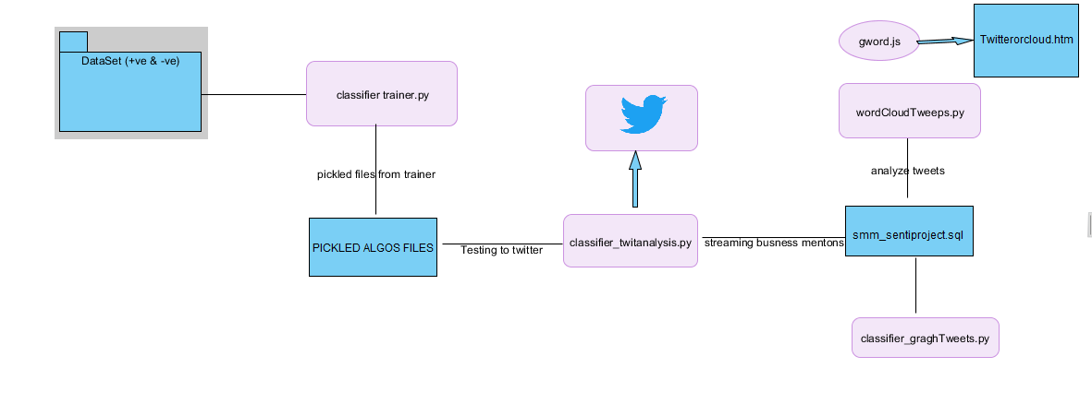
Module Flow of the system

Slide 21
Thank You

